Slide 2
A Smart Payload System for Use in Industrial Settings
Edward Venator
EECS 600
Case Western Reserve University

Slide 3
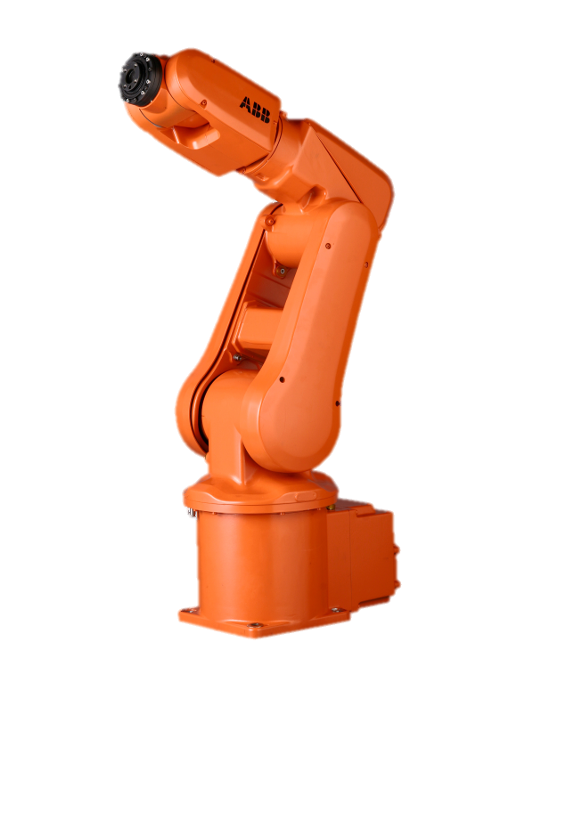
Purpose
Mobile manipulators in industrial settings can benefit from a database of information about the objects they manipulate.
Notes:
My Masters thesis concerns the construction of a mobile manipulator consisting of an ABB IRB-120 robotic arm mounted on a mobile based originally designed for an electric wheelchair.
The ultimate purpose of this robot is to perform “kitting” operations in a factory environment. The robot must retrieve combinations of items from inventory and deliver them to stations on an assembly line.
In a factory environment, it is possible to catalog manipulable objects into a database. That database can hold a wealth of information about the objects, and the information can be retrieved via object tags such as QR codes, bar codes, or RFID tags.
By standardizing this information, it would be possible to “commoditize” manipulable object data. Items that come in the same box wouldn’t have to be separately modeled for robotic manipulation, but could simply be tweaked for properties like mass. Since so many packages are already tagged with barcodes or RFID tags, most packages would require little alteration.
The question is:
What information should be included?

Slide 4
Project Objectives
Determine the state of the art in smart payload systems.
Determine what object data is most useful for manipulation.
Fuse inventory management and object manipulation technologies to implement a rudimentary database system.
Demonstrate a basic smart payload system that can provide useful manipulation data for at least one object.
Notes:
There’s a lot of research on how a robot can find or recognize objects in an environment, but not a lot on how to help facilitate that. The holy grail of robotics research has been a general purpose “household” robot. Meanwhile, we still don’t have a general purpose industrial robot. We have robotic arms, and we have robotic fork lifts, but we don’t have something that can go grab two pipes and a fitting unless you tell it explicitly where they are and how to grab them.
To accomplish this project, I first need to determine exactly what the state of the art is in this field. As far as I can tell, most of the explorations have been directed toward general purpose object recognition and manipulation, but the results can be applied to this problem, which I’ll discuss later.
From that existing research, I plan to decide what properties are most salient to a mobile industrial manipulator – things like grasp affordances, mass, volumetric data, visual cues for registration.
In order to provide this data to a robot, it must be stored in a database and retrieved on demand. In an industrial environment, this is accomplished by a complex inventory management system that performs many other duties such as supply chain management. In my case, I’ll be using a simple database in its place.
By the end of this project, I plan to demonstrate a basic but extensible system that can store and serve information about at least one object.

Slide 5
Project Scope
Within the Scope
Beyond the Scope
Perform extensive research on manipulation and grasp
Determine salient criteria to describe manipulable objects
Design a system that stores grasp and manipulation data about objects.
A high-level exploration of how to act on information from
Physically realizing this system with a robotic arm or mobile manipulator.
Low-level (kinematic) algorithms for object manipulation.
Extending this system to multiple gripper types.
A production-ready software or database system.
Notes:
Creating a comprehensive system for describing objects would be a huge task, so I’ve narrowly defined the scope of this project.
The main thrust of this project is investigating what criteria would be helpful to an industrial mobile manipulator. This involves research into manipulation and grasping.
A secondary goal of this project is to use that information to create a high-level description of a system that serves this information to the robot, and describes how the robot uses that information to accomplish its goal of finding and grasping objects in an industrial setting. This includes how the robot can use information to help identify and register an the object within its perception and how the robot can use information to assist in grasping and manipulating an object.
There are several things that are beyond the scope of the project. First, although I am in the process of constructing the robot that will eventually perform the tasks described by this project, it is not itself part of the project, and I don’t expect to realize this system in a physical system by the end of the semester.
Since the project focuses on the conceptual challenges of what kind of information to store about smart playloads and how to act on it, low-level algorithms such as arm kinematics and path planning are beyond the scope of the project.
In a real environment, such a system would have to be extended to allow for many different types of robots with different types of grippers. My masters research focuses on using only parallel-plate grippers, as will this project. The information provided by the system would be useful to other types of robots, but I won’t be exploring this.
Although I intend to prototype this system with a simple database server and a proof-of-concept robotic client, I won’t be creating anything approaching production-ready software for either server or client.

Slide 6
Background
Castellini, C.; Tommasi, T.; Noceti, N.; Odone, F.; Caputo, B.; , "Using Object Affordances to Improve Object Recognition," Autonomous Mental Development, IEEE Transactions on , vol.3, no.3, pp.207-215, Sept. 2011
Bley, F.; Schmirgel, V.; Kraiss, K.-F.; , "Mobile Manipulation Based on Generic Object Knowledge," Robot and Human Interactive Communication, 2006. ROMAN 2006. The 15th IEEE International Symposium on , vol., no., pp.411-416, 6-8 Sept. 2006
Grasp researchers such as Cutkosky
Manipulation researchers such as Kemp and Edsinger
Notes:
Much research in this field focuses on recognizing/finding arbitrary objects by vision or 3D vision techniques
Grasp researchers such as Mark Cutkosky at Stanford
Manipulation researchers such as Charles Kemp at Georgia Tech and Aaron Edsinger at MIT

Slide 7
Why Encoded Smart Payloads?
Robots aren’t ready for “human environments”
Extends industrial robotics to less-controlled situations
Reconfigurable on-the-fly
Packages are already labeled
Notes:
Whereas most research has focused on being able to bring robots into human environments, this is still a long way off. There are a lot of challenges in getting a robot to be able to recognize household objects.
On the other hand, there’s no reason that we can’t have more robots in industrial environments now. Currently, robots can only perform fully controlled tasks. Parts need to be presented to them in neat rows, and they execute the same repetitive tasks. Smart payloads extend industrial robotics to semi-controlled environments, such as small-run production factories and inventory systems that were designed for humans.
With the aid of smart payloads, robots can be quickly and easily reconfigured because they can interact with their environment and react to the objects they interact with. Reprogramming a robot becomes as simple as telling it what to get and where to bring it, rather than having to give it an explicit path. Once it finds the objects it needs to manipulate, it can read information from the objects themselves, just like a human would. This saves the steps of painstakingly modeling every object the robot interacts with.
Most packages used in an industrial environment are already labeled. The labels might need to be adapted to be more machine-friendly, but unlike in a home, labeling everything the robot works with is a reasonable solution.

Slide 8
Methods
Continue reviewing manipulation literature.
Evaluate candidate properties for encoding based on criteria such as usefulness for manipulation, data density, and computational complexity.
Prototype software and high-level manipulation algorithms for a robot to query an object database and act on the information it receives.
Based on the high level algorithms, prove that the information the robot receives is sufficient for the robot to interact with an object and that the smart object makes the robot’s task simpler.
Notes:
This project begins with a literature review of grasping and manipulation in general, and any research that may exist on smart payloads. In my reading so far, I’ve found a lot about identifying and grasping objects with no a priori knowledge of the object and with complete a priori knowledge of the object, but in both cases, the object was unlabeled. I’d like to do a bit more research to see if anything has been done with this, but I think this is a different approach to the problem.
I’ll be evaluating different types of manipulation data based on how useful they are to a manipulator, how much information can be transmitted in how much data – a full CAD model contains a lot of information, but it’s all a lot of data, whereas a simpler representation of an object might be more efficient. Where possible, I’d like to reduce the computation that the robot needs to do. If something can be precomputed without losing generality, it should be.
In order to evaluate different properties and see how they fit into an overall control scheme, I’ll have to prototype software for high-level control.
Using the software and algorithms I develop, I should be able to simulate high level planning, and from there I can see how different planning schemes that depend on different smart payload data perform. Ultimately, I can decide what information smart payloads should give the robot.

Slide 9
Questions

